Slide 2
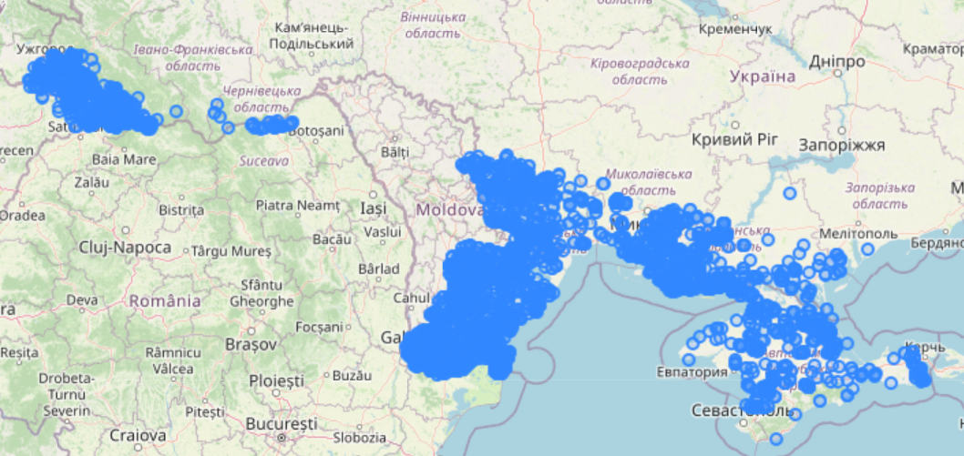
First Model: 9-64-2 ReLU
Accuracy: 100%
Epochs: 394
Loss: 0.015
Batch Size: 256, 64
Attacks before: 0
Attacks after: 116.096
Accidents before: 10.115
Acccidents after: 10.043 Heavy bias with the lat lon components, didnt learn fire patterns

Slide 3
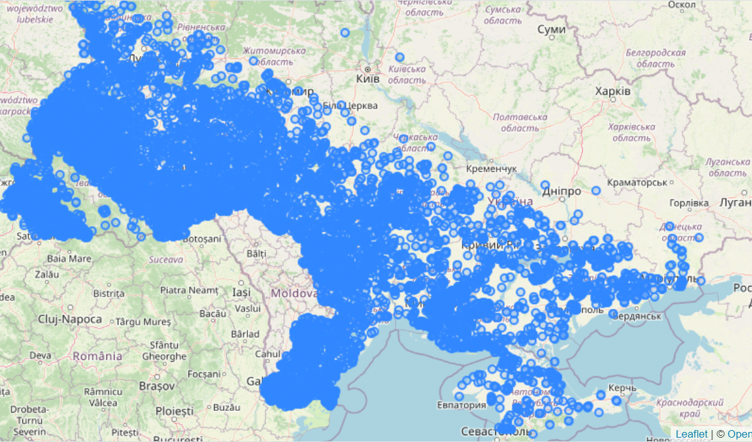
Second Model: 9-32-32-2 ReLU
Accuracy: 99,995%
Epochs: 620
Loss: 0.011
Batch Size: 256, 64
Attacks before: 3
Attacks after: 102.583
Accidents before: 10.112
Acccidents after: 23.444 Learned a lot more than the first model but still is heavy biased with lat lon

Slide 4
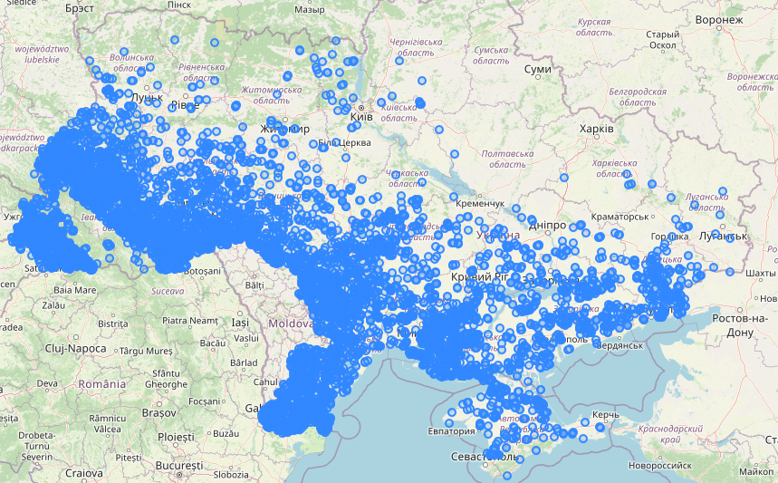
Third Model: 9-32-32-32-2 ReLU
Accuracy: 98,68%
Epochs: 50
Loss: 0.041
Batch Size: 256, 64
Attacks before: 0
Attacks after: 109.733
Accidents before: 10.115
Acccidents after: 16.294 Spreaded more evenly and close to wooded areas

Slide 5
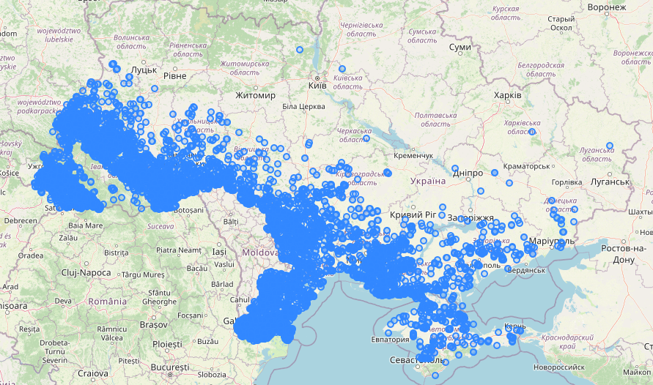
Fourth Model: 9-8-8-8-8-8-2 ReLU
Accuracy: 98,68%
Epochs: 81
Loss: 0.015
Batch Size: 1024, 246
Attacks before: 3
Attacks after: 113.195
Accidents before: 10.115
Acccidents after: 16.407 Same as the others, no improvements noticed

Slide 6
Failues
Acurracy: 50%
Epochs: 50
Loss: 0.69
Batch Size: 32 – 4064, 8 - 1024
Tanh, Sigmoid
5 depth
512 wide
Remove population density parameter
Did not converge, assumed everything as one class

Slide 7
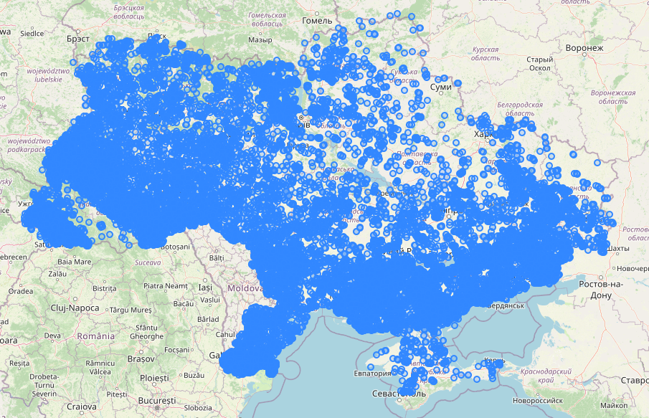
Fifth Model: 8-8-8-2 ReLU
Removed the date parameter
Accuracy: 91,79%
Epochs: 399
Loss: 0.23
Batch Size: 256, 64
Attacks before: 1.055
Attacks after: 83.423
Accidents before: 9.394
Acccidents after: 49.777 Now is spread a lot more in the whole country

Slide 8
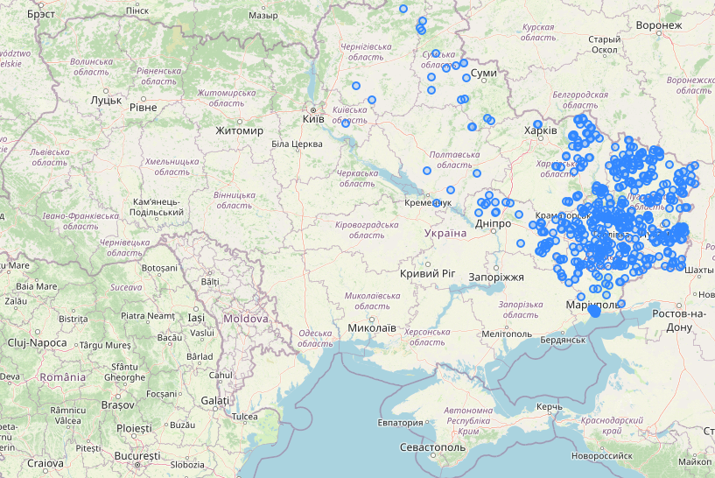
Breakthrought!
Attacks before the war, Only near the donbass conflict zone Where fight actually took place.
Unfortunatelly, still mostly random classification.

Slide 9
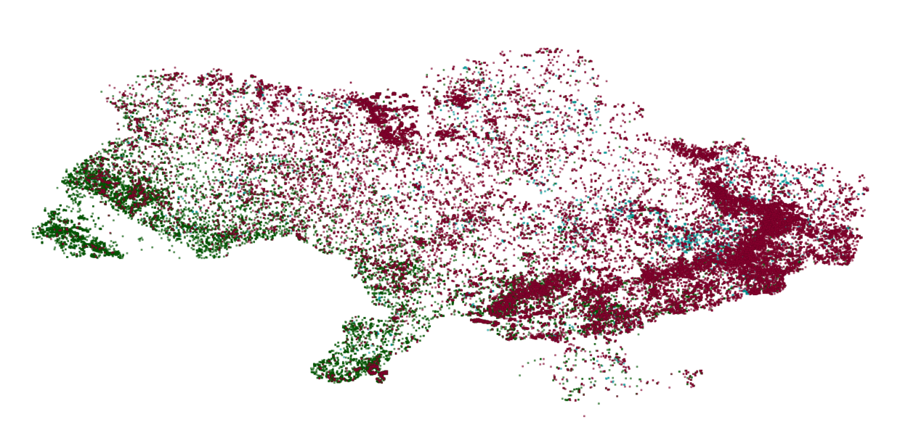
Distribuition

Slide 10
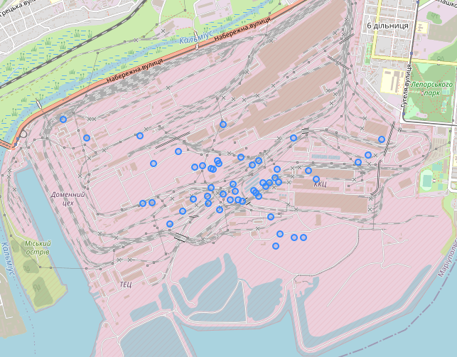
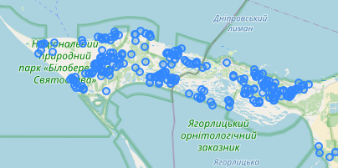
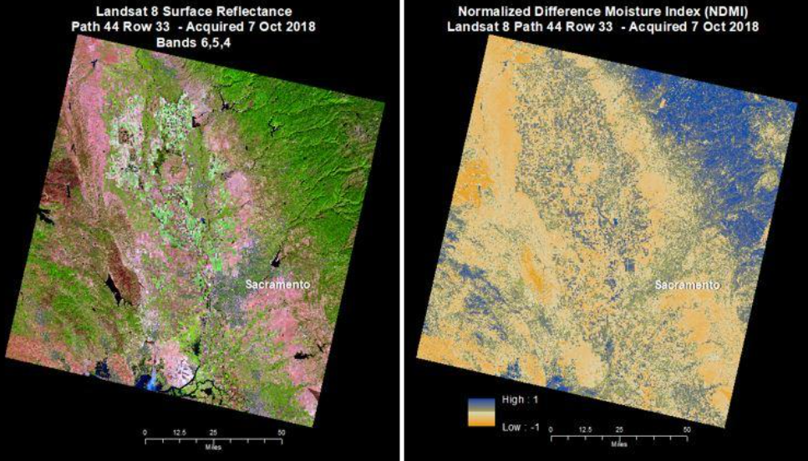
Conclusion
My dataset is still low quality
Lots of false positives
Need to define better the difference between the two classes
Add more classes
Understand how to diferentiate thermal anomalities
Add back time componente without heavy bias
Use NDMI to annotate and classificate forest fires
Use diferente models
Accidental fires detected in a factory,
but is just hot forges and kils
Attacks on a area that was not attacked,
clearly a nature reserve
NDMI

